Slide 1
Tableau Integration with Hortonworks HIVE
Prof. Ramesh Ragala
VIT Chennai

Slide 2
Installation of Hortonworks
Install Hortonworks
Open Hortonworks in VMPlayer
The initial screen displays the IP address, where hortonworks works
Use that IP address on URL of any Browser
The screen shot of the same as follows…

Slide 3
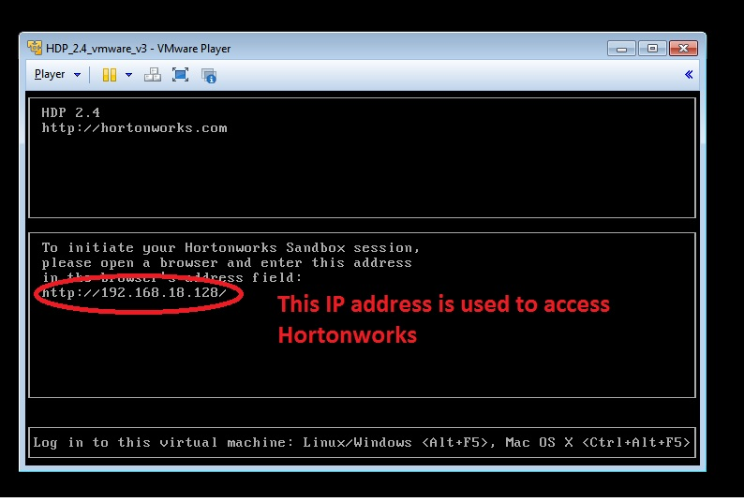
Installation of Hortonworks

Slide 4
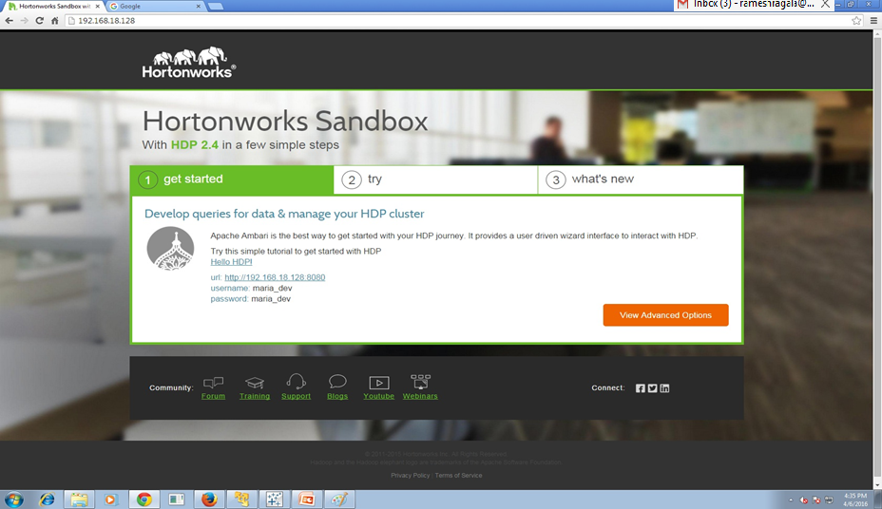
Installation of Hortonworks
Home page after opening the hortonworks in browser

Slide 5
Installation of ODBC driver
Install of ODBC Driver
It can be two type 32 bit ODBC driver and 64 bit ODBC Driver.
Choose appropriate ODBC Driver for your local machine
Use next .. Next button to install ODBC driver in your local machine.

Slide 6
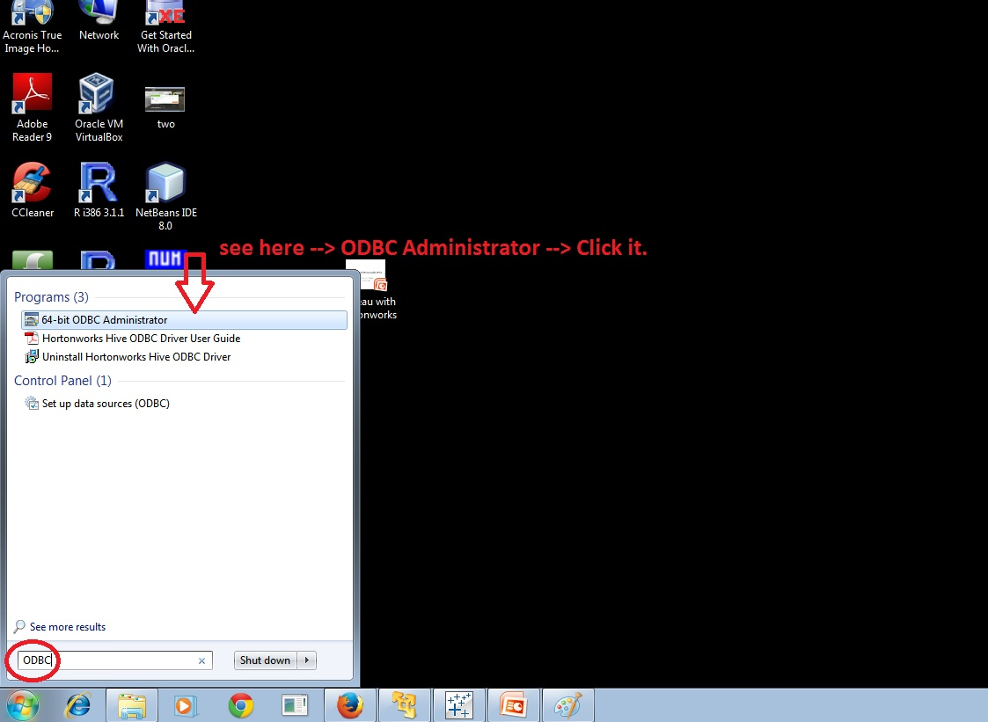
Installation of ODBC driver
After Installation of ODBC Driver:
Open ODBC Driver : start menu → search (ODBC)

Slide 7
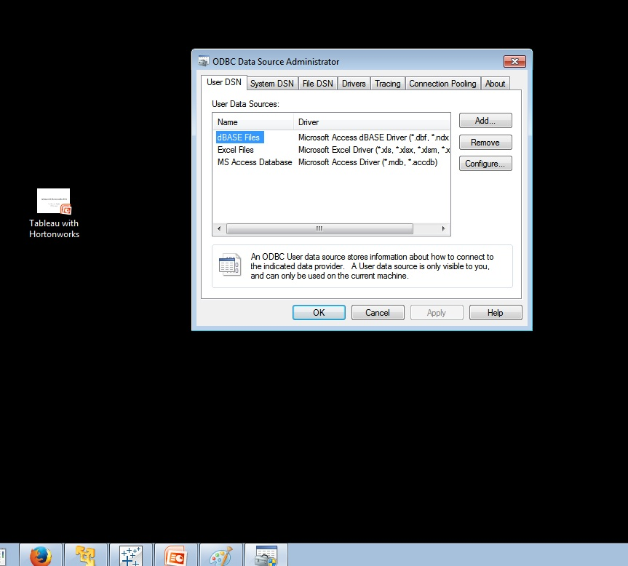
Installation of ODBC driver
After Installation of ODBC Driver:
Once you opened ODBC, it will be like this

Slide 8
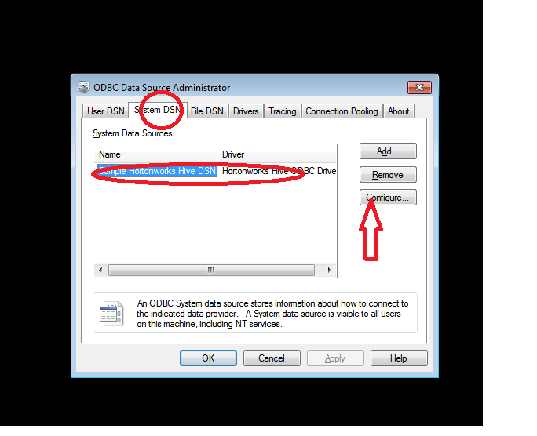
Installation of ODBC driver
After Installation of ODBC Driver:
Open System DNS tab in ODBC Driver.
Here you need to configure

Slide 9
Installation of ODBC driver
After Installation of ODBC Driver:
Open System DNS tab in ODBC Driver.
Here you need to configure
IP address field can be given as your hortonworks IP address
Port number is 10000
Database: default → which is available in hortonworks HIVE.
Hive server type → Hiver Server 2
User Name as sandbox
After configuration, Test the connection by clicking Test button which is @ bottom.
If the result is successfully connected. Then you are able access the data which in Hortonwork HIVE using Tableau

Slide 10
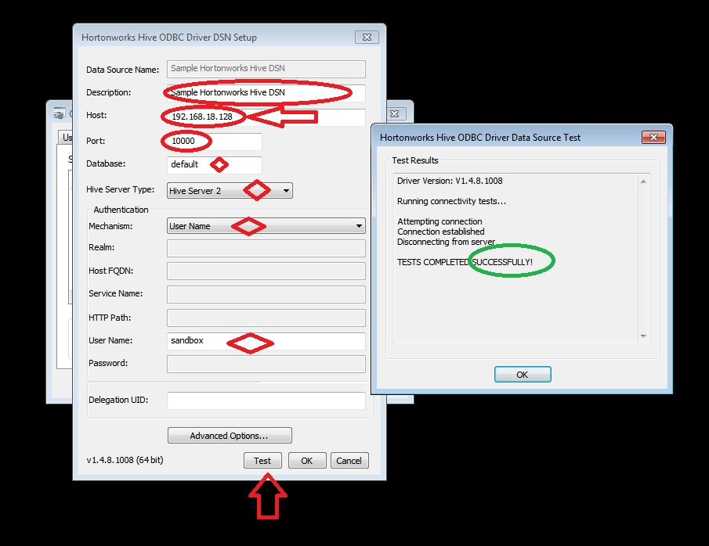
Installation of ODBC driver
Configuration of ODBC Driver:

Slide 11
Creation of Database in Hive
Open Hortonworks in URL with following details:
The ip address : http://yourmachine_hortonworks IP address:8080(portnumber)
Example: http://192.168.18.128:8080/
Once opened, it ask username and password
Username: maria_dev
Password: maria_dev

Slide 12
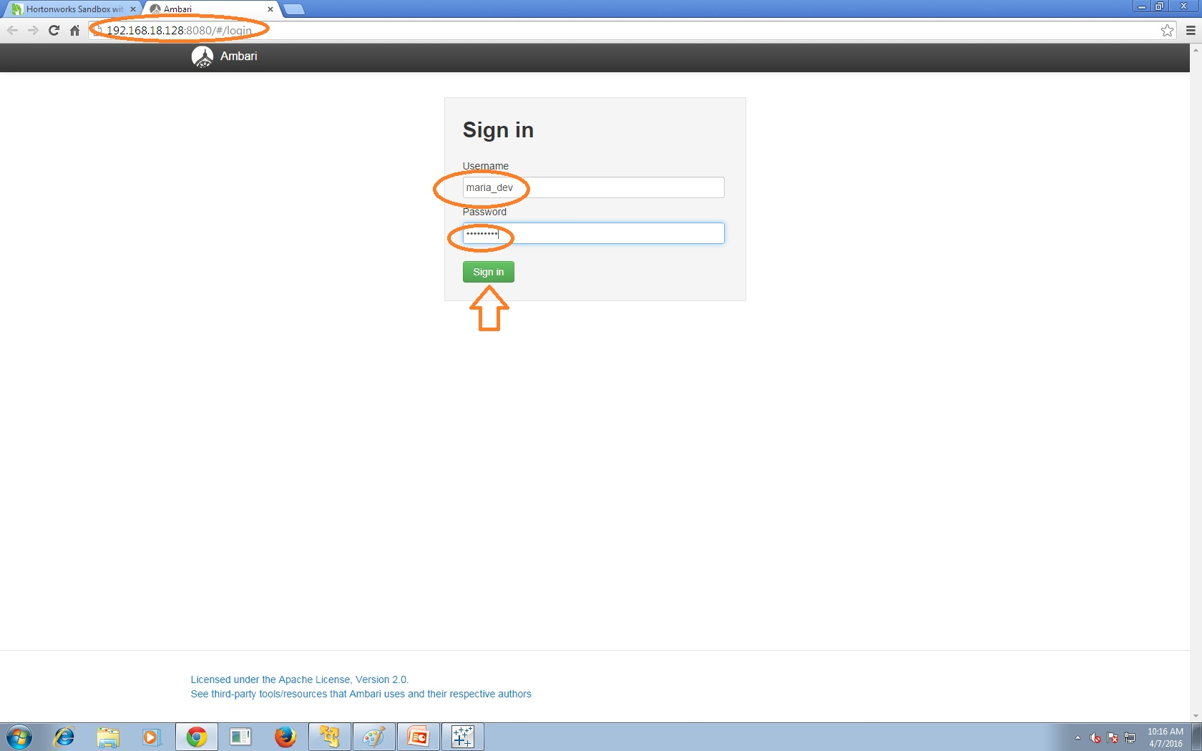
Hortonworks login page

Slide 13
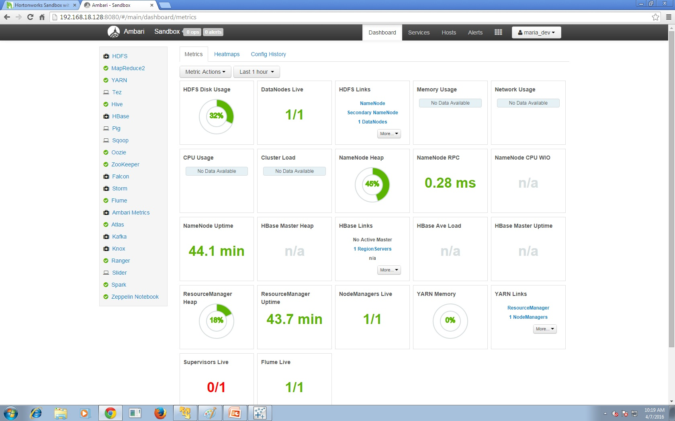
Hortonworks home page after login

Slide 14
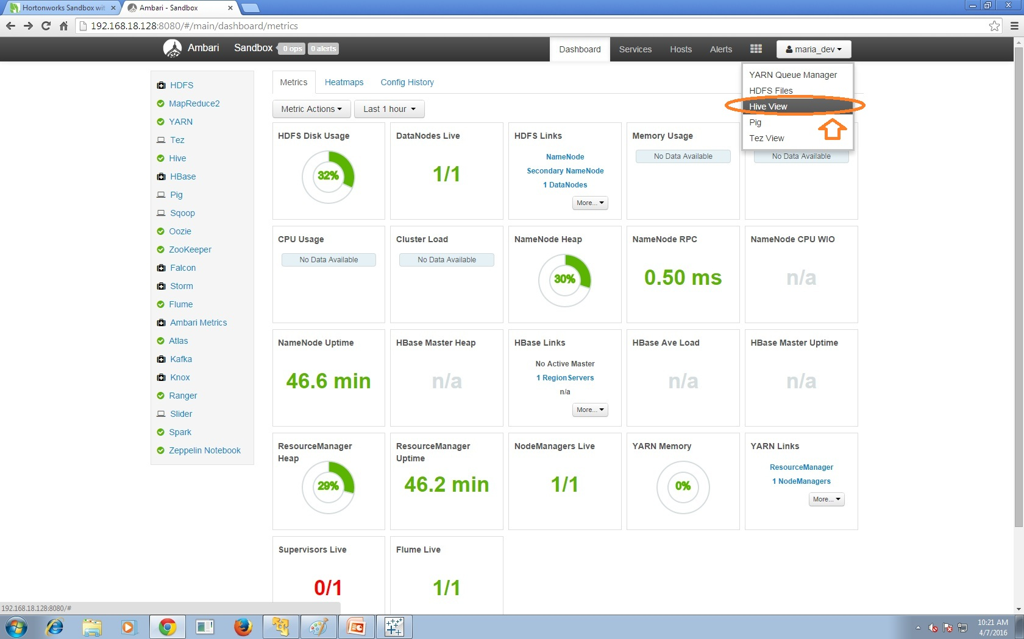
Hive in Hortonwork

Slide 15
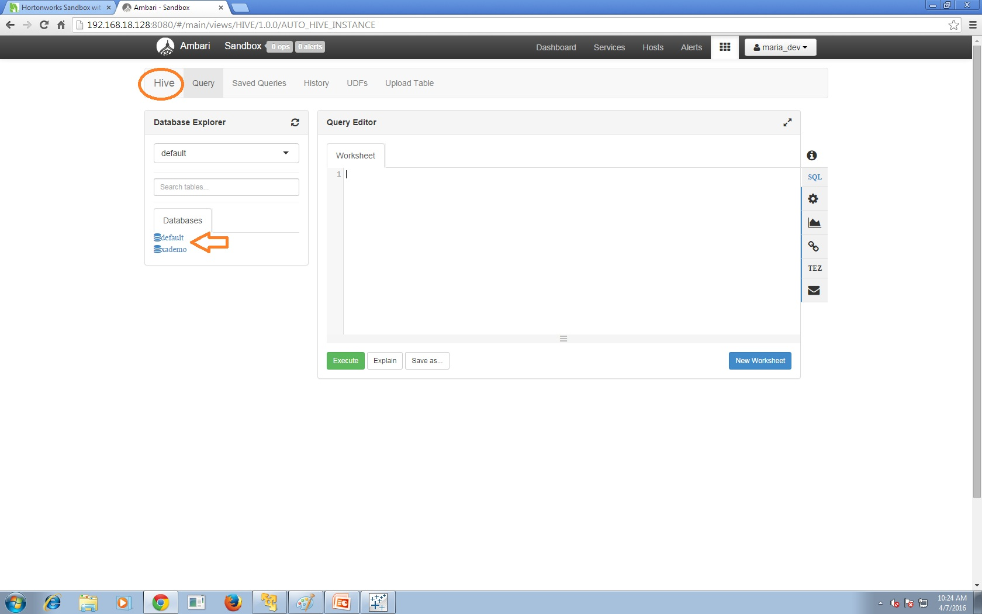
Hive GUI in Hortonwork

Slide 16
Create a dataset
Open new Excel sheet
Template as follows:
Variables are Name, fee and marks
Name as String data type
Fee as Int Data type
Marks as Int Data type
Many instances for all variables
Save the current sheet as .csv file
Saved .csv dataset is named as data26
i.e the dataset is data26.csv

Slide 17
Upload dataset into Hive
Open Hortonworks Hive
There is an option to upload table → click it
It asks the File. Select file to upload
It checks the data types of the variables in dataset.
If you want, change accordingly.
Here it will take the name of the dataset as a name for table.
There is a option to change the databases too.
After checking the data types, press upload button.

Slide 18
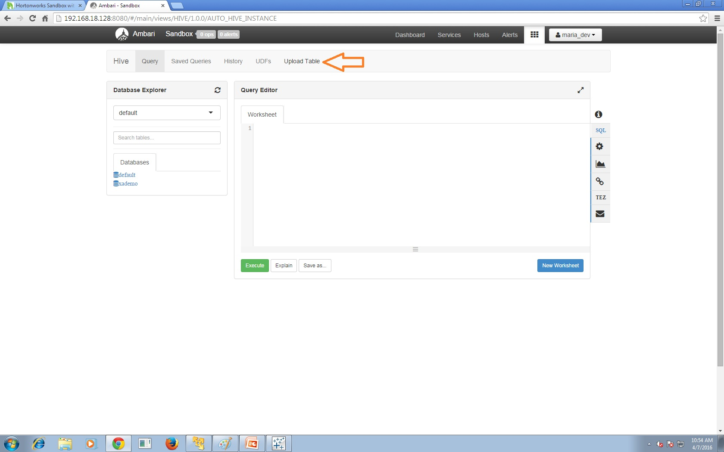
Upload dataset into Hive

Slide 19
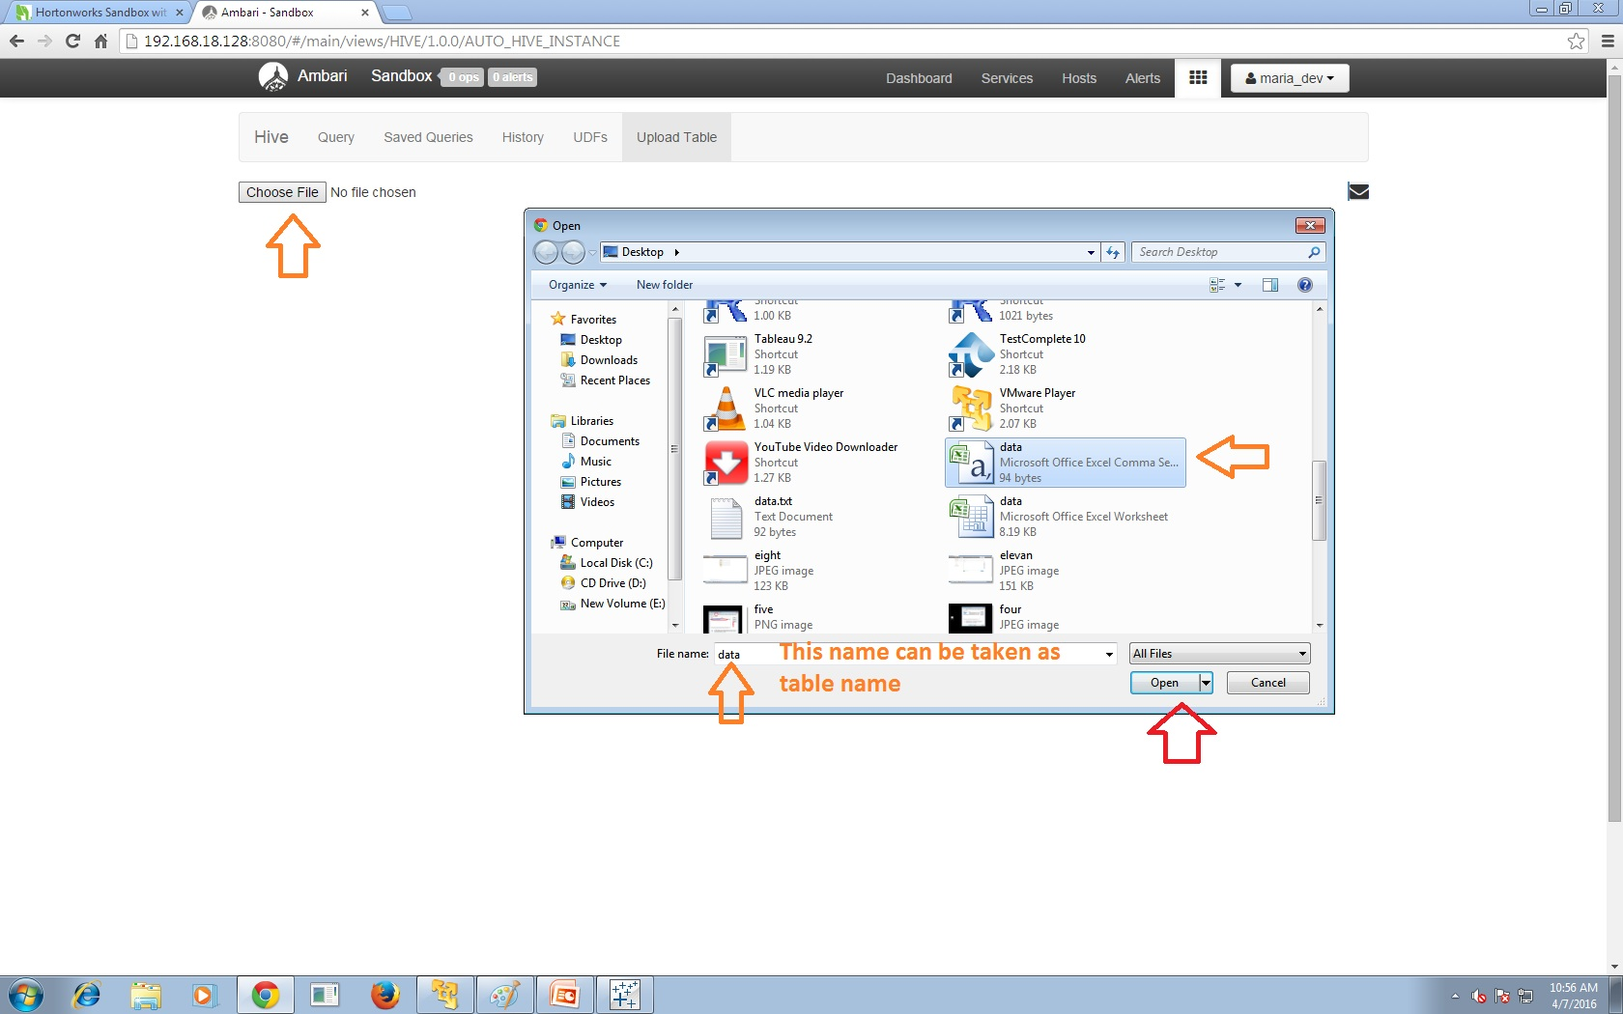
Upload dataset into Hive

Slide 20
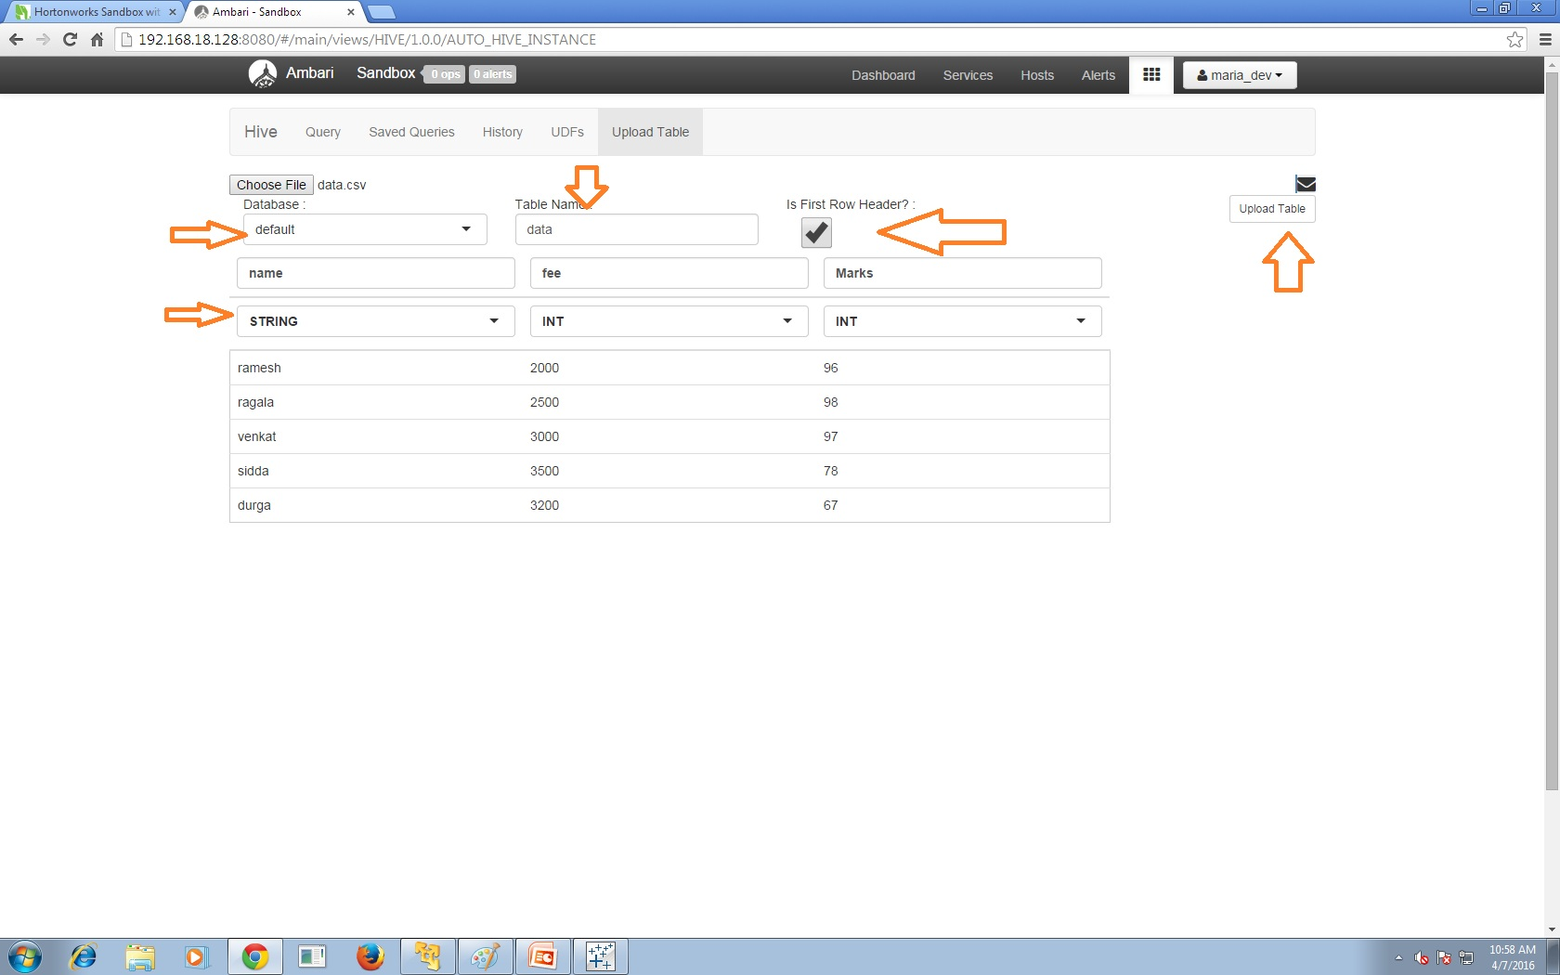
Upload dataset into Hive

Slide 21
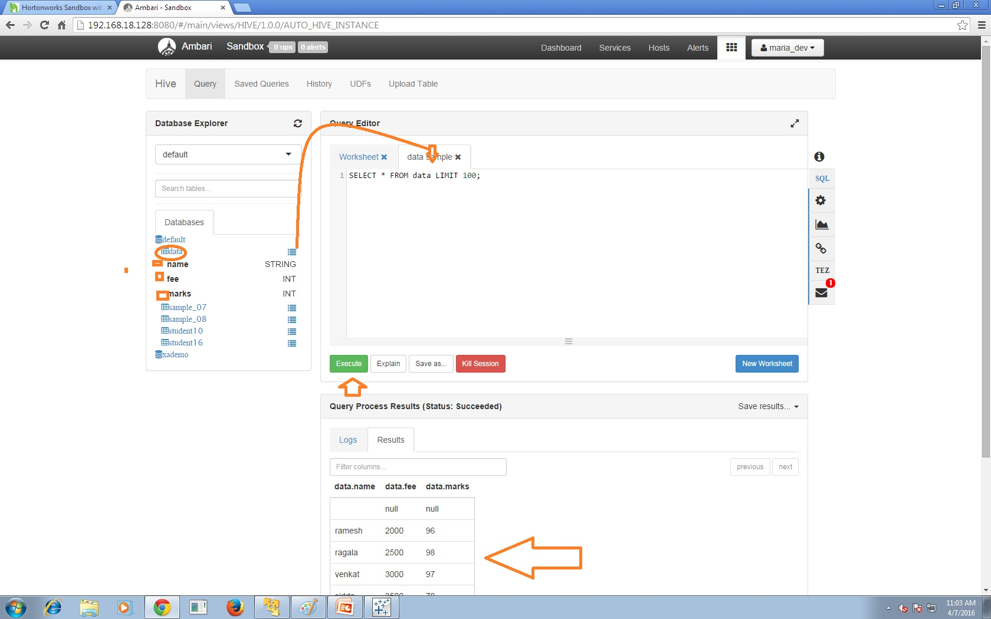
Checking data in Hive

Slide 22
Connecting Hive with Tableau
Open Tableau 9.2
Open new worksheet
Click Data menu
Click New Data Source
Click More servers
You are able to see Hortonworks hadoop Hive
Click it

Slide 23
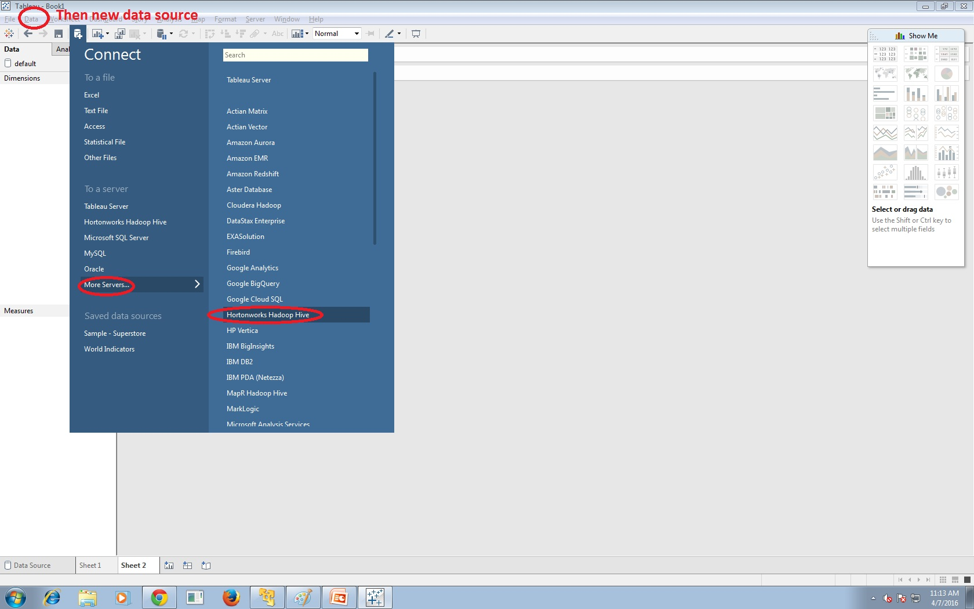
Connecting Hive with Hadoop

Slide 24
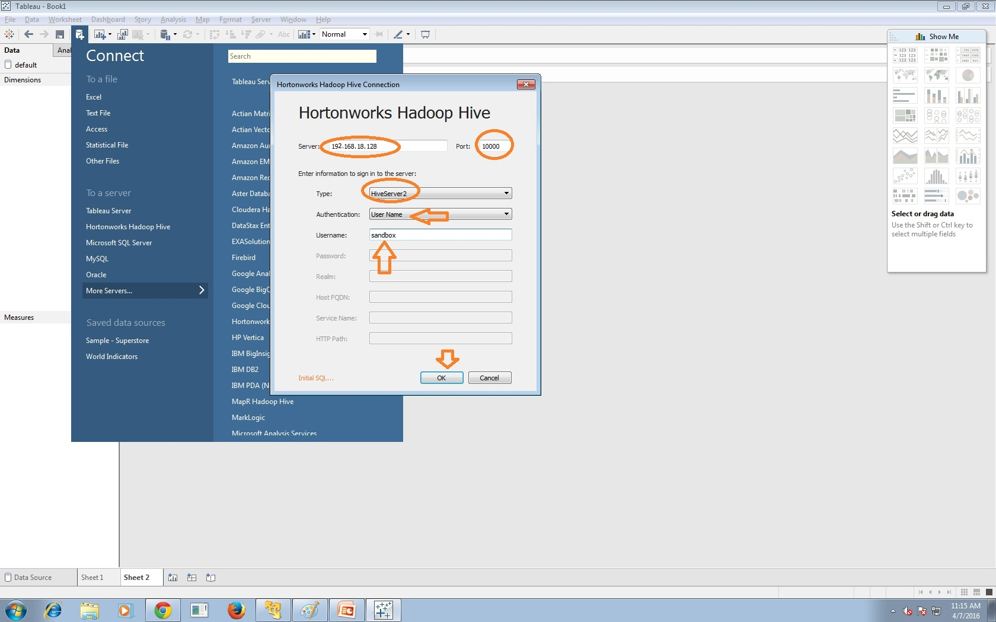
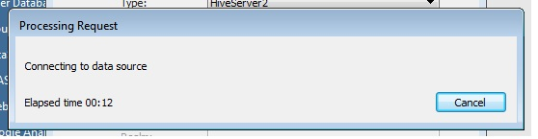
Connecting Hive with Hadoop

Slide 25
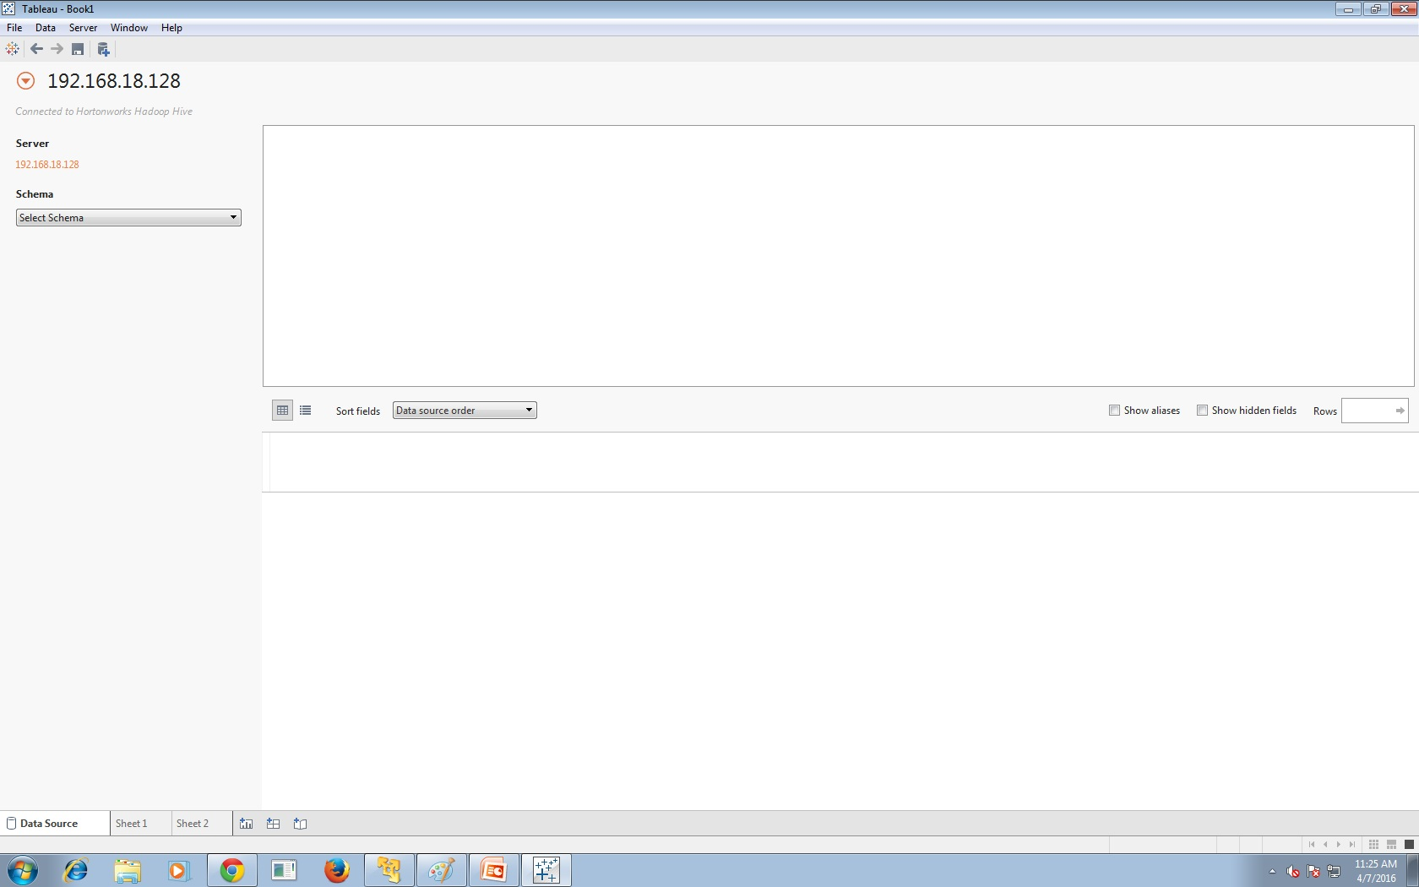
After Connecting Hive with Hadoop

Slide 26
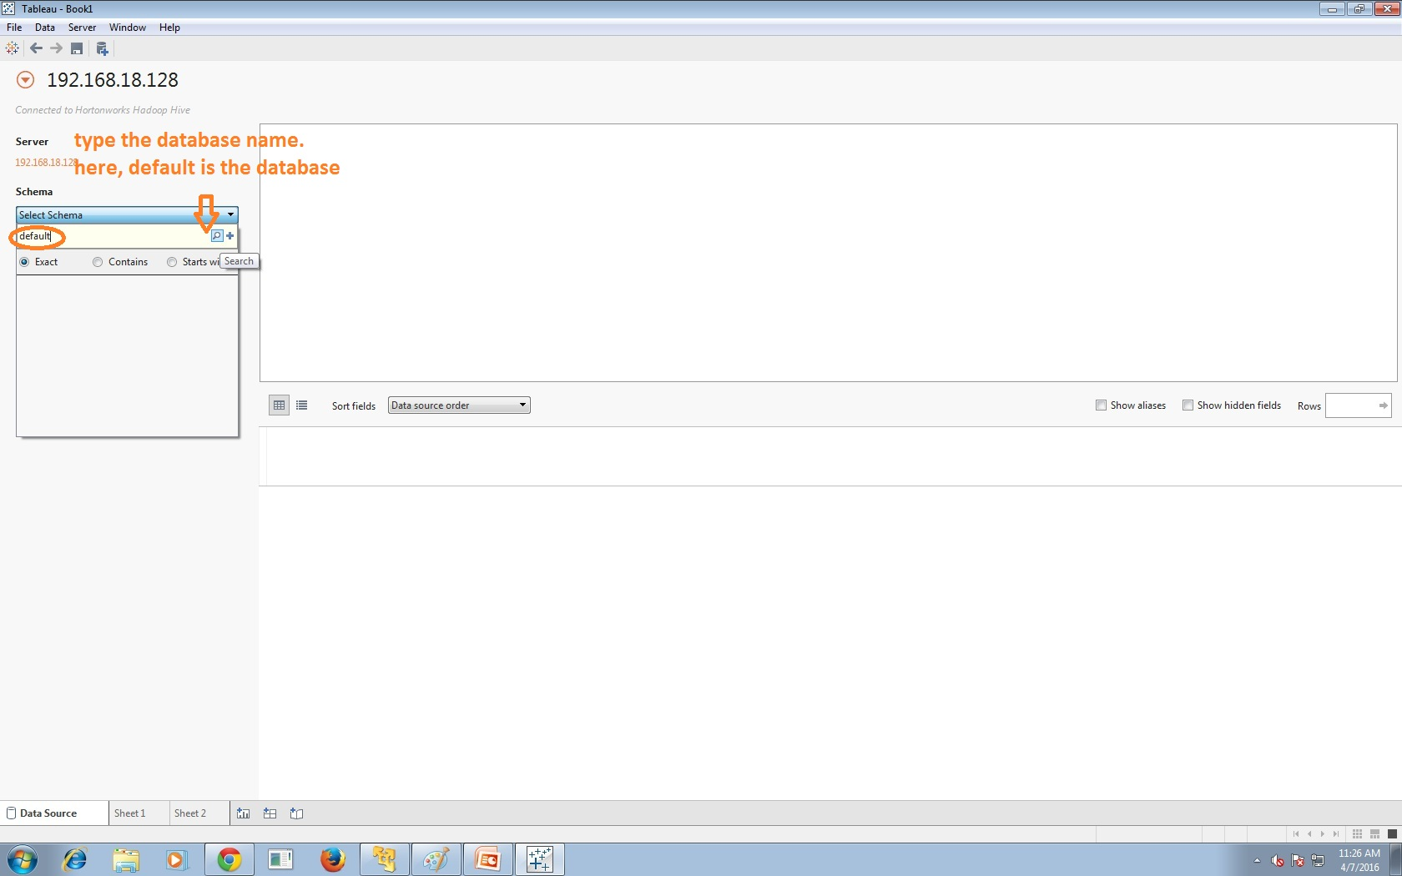
After Connecting Hive with Hadoop

Slide 27
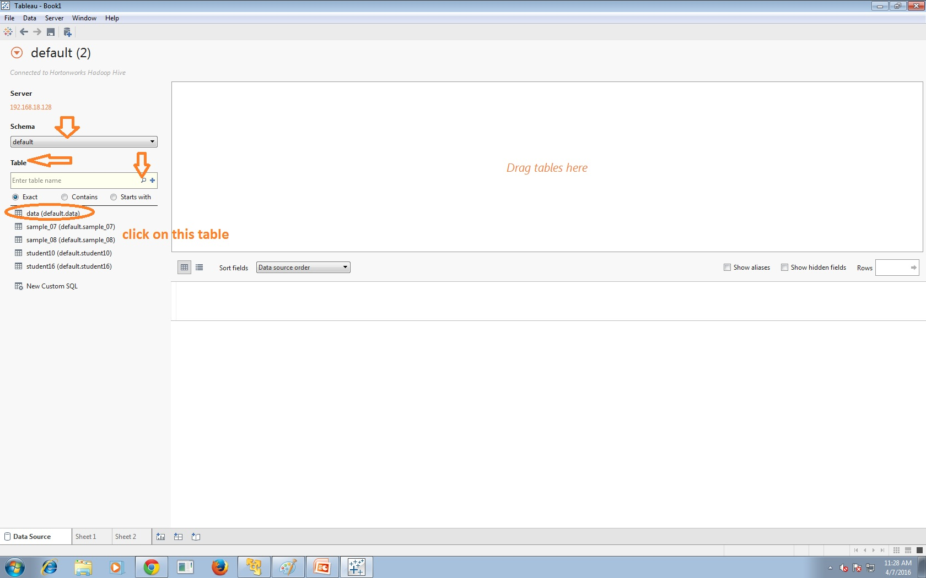
After Connecting Hive with Hadoop

Slide 28
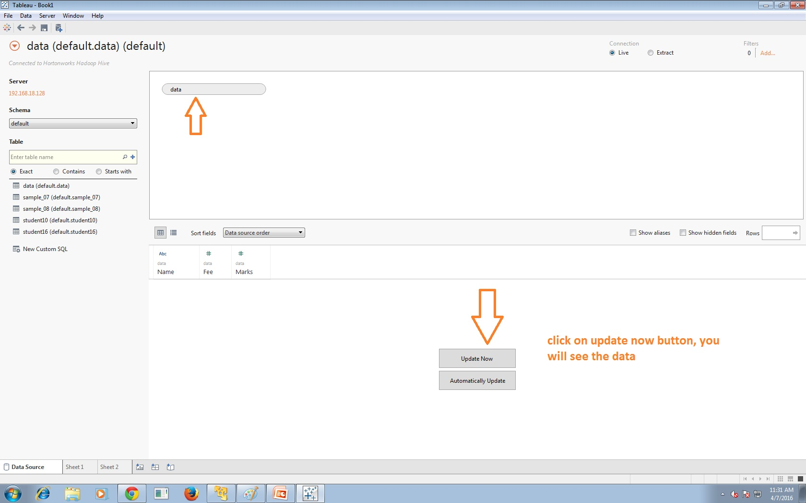
After Connecting Hive with Hadoop

Slide 29
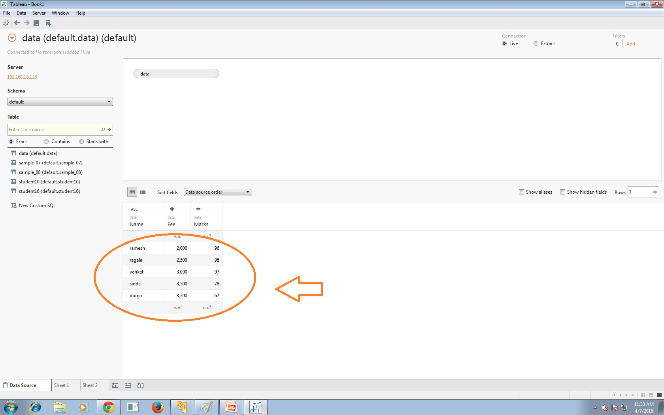
After Connecting Hive with Hadoop

Slide 30
Connecting Hive with Tableau
Open the worksheet
You are able to see the dataset, which we got from Hortonworks HIVE.
Now you are ready to do visualization

